Slide 1
Good Laboratory Practices (GLP)
Tejas Karandikar

Slide 2
Contents
What is GLP? (Definition and Importance)
Practicing GLP
Guidelines to GLP
Documentation of laboratory work
Preparation of SOPs
Calibration records (implementation in laboratory)
Significance of Validation in GLP
Transfer of methods
Documentation of results

Slide 3
What is GLP?
GLP is a quality system concerned with the organizational process and the conditions under which a study is planned, performed, monitored, recorded, archived and reported.
It was first introduced in the year 1972 in New Zealand and Denmark.
In the US, it was established after there were cases of fraud in the data submitted to the FDA by pharmaceutical companies.
After these issues were made public at the hearings in US Congress, US-FDA and EPA, which had come across similar problems, published the final rules of GLP in 1979 and 1983, respectively.
OECD declared that data generated in the testing of chemicals in one OECD Member Country, in accordance with OECD Test Guidelines and the Principles of GLP are accepted in all other OECD Member Countries after the Decision C(97),186/Final of the OECD Council.
Notes:
3) e.g. One such prominent case was at IBT (Industrial BioTest Labs) where many safety tests for chemical manufacturers were claimed to be performed or they were so poor in performing tests that the investigators couldn’t piece together the work that had been done, even though IBT claimed that they had submitted their test results which the manufacturing company asked, as per their contract.
4) EPA= Environmental Protection Agency
5) OECD= Organisation for Economic Co-operation and Development, OECD member countries- USA, UK, Canada, France, etc. Total OECD member countries- 36

Slide 4
Importance of GLP/ Why to follow GLP?
Nowadays, all the pharmaceutical companies and other labs invest heavy amounts in ensuring that they follow the principles and guidelines of GLP.
This is because GLP is an important set of principles and practices for several reasons, some of which are given below.
A) GLP ensures that the results obtained from laboratory testing are not only of a good quality but are traceable as well. This traceability makes sure that if any wrong materials, methods or equipment are used, it can be identified and if any issue arises or if wrong result is obtained, it can be corrected.
B) The labs that follow GLP gain a higher reputation than the ones who don’t follow it, so, GLP is helpful in enhancing the reputation of a lab or a manufacturing company.

Slide 5
C) Following GLP means that the analysts and the employees above the analysts as well must keep clear records of the test procedures and the methods which are used for performing that test/ analysis.
This ensures that frauds are minimized by a lab because the paper trail of the records can be referred to.
As the frauds are minimized, the legal costs of the lab or the company are also reduced.
D) As GLP makes it necessary to have written procedures for testing and demands that supporting documentation be made, another analyst in the lab can perform the testing in the same way in which the earlier analyst had performed, thus ensuring that the results are valid.
E) GLP also ensures the safety of each and every personnel working in the lab, the aspects of which, we will study later on.

Slide 6
Practicing GLP
As stated earlier, GLP covers all aspects of the study ranging from its planning to reporting.
So, while practicing GLP, all of the principles which take these aspects into consideration must be followed.
Following are the principles of GLP as per OECD:-
A) Organization and Personnel
B) Quality Assurance Programme
C) Facilities

Slide 7
D) Apparatus, Materials and Reagents
E) Test Systems
F) Test and Reference Items
G) Standard Operating Procedures
H) Performance of the Study
I) Reporting of Study Results
J) Storage and Retention of Records and Materials

Slide 8
Guidelines to GLP
To ensure that the principles of GLP mentioned previously are followed/ to ensure that the labs and pharmaceutical companies comply with GLP, various guidelines were drafted by various governing/ regulatory bodies. Some of them are mentioned below.
OECD in the year 1981 published the OECD Guidelines for the Testing of Chemicals which are guidelines that usually must be followed by agencies which carry out the risk assessment of chemicals.
http://www.oecd.org/chemicalsafety/testing/oecdguidelinesforthetestingofchemicals.htm

Slide 9
The US-FDA has rules for following GLP in the section 21 CFR 58 which are followed during the pre-clinical trials on animals prior to clinical research in humans.
If a new drug application must be supported/approved in the US, these rules must be followed, whether by the US itself or by other countries.
Since the year 1987, the European Council has adopted two basic directives and a decision relating to the application of GLP principles.
They are:-
A) Directives- Directive 2004/9/EC and Directive 2004/10/EC

Slide 10
B) Decision- 89/569/EEC Council Decision
There are also certain product-oriented directives like REACH regulation, Directive 2006/121/EC (for chemicals), Directive 2001/83/EC (for products related to human medicinal use), etc.
EU has also formed Mutual Acceptance Agreements in areas of GLP with Japan, Israel and Switzerland.
The above-mentioned Directives and other European regulations now also apply to countries like Iceland, Norway and Liechtenstein because of the Treaty of the European Economic Area of 13 September 1993.

Slide 11
Documentation of Laboratory Work
The entire activities in a laboratory revolve around one key sentence:- “If it is not documented, then it is not done.”
Thus, documentation is a very critical aspect of compliance with GLP.
Documentation ensures traceability of the entire study in case if something goes wrong during the study.
Proper documentation also proves that the study done, or the analysis/ test performed is accurate, precise and reliable.
Laboratory documents are also used to review the activities which have taken place in the lab.

Slide 12
To ensure that all the laboratory work is properly documented, certain practices must be followed while documenting the activities carried out.
These practices are known as Good Documentation Practices (GDP/GDocP).
Some of them are:-
A) The documents must be hand-written in indelible ink.
B) Sufficient space is provided for handwritten entries.
C) Errors are corrected and reason for error is written.
D) No ditto marks are allowed.

Slide 13
Preparation of SOPs
The Standard Operating Procedure (SOPs) are documents that describe how to perform various routine operations in a GMP-based manufacturing or research facility.
They provide a general framework which helps in the efficient implementation and performance of all the functions and activities and contain step-by-step instructions that the personnel consult daily to complete their tasks in a reliable and consistent manner.
Basically, SOPs are written commitments to the regulatory bodies that describe the performance of routine tasks.

Slide 14
SOPs cover certain general factors like test systems and methods, use, care and cleaning and calibration of equipment, documentation, use of facilities such as cleanrooms, etc.
The SOPs must be comprehensive enough so that the staff can complete the procedure.
Information that should be listed includes the preferred suppliers of chemicals, reagents, and equipment; the catalogue numbers of reagents and the model numbers of equipment; the storage conditions and stability of chemicals and test substances; and acceptance criteria for valid procedures.

Slide 15
SOPs should be written by personnel who are familiar with the procedure and then approved by the management team.
They should be written in language that will be understood by the person using the SOP and checked for accuracy and quality.
An SOP should be signed and dated by authorized personnel and, ideally, include the printed name of the signatory.
All SOPs should be reviewed regularly, and the review date must appear on the documentation.
They should be accessible to all and refer, when relevant, to product quality specifications. Above all, an SOP must be clearly presented and followed.

Slide 16
For preparing a SOP, there is a format which is followed by the employee writing the SOP.
This format can vary from organization to organization, but there are certain common/ essential categories included like:-
Title and purpose (why it is written)
The scope (where does it apply)
The responsible party (who must apply it)
References and other documents
Safety considerations (such as the use of protective clothing or disposal procedures) and others like the procedure to be followed and documentation requirements.

Slide 17
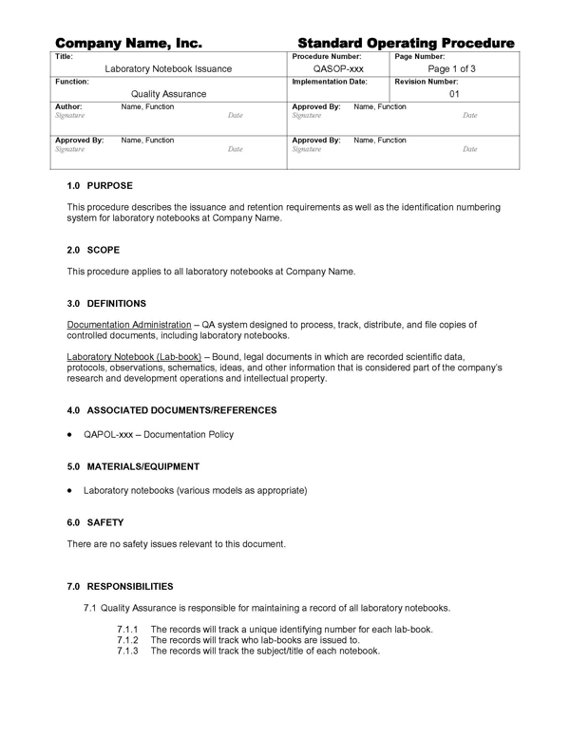
Example SOP

Slide 18
Calibration Records (Implementation in Laboratory)
Calibration refers to the act of evaluating and adjusting the precision and accuracy of measurement equipment.
In a lab, it is a critical activity without which the results of a test or a study obtained are not reliable.
Each step of the calibration requires that records be kept and maintained.
These are basically documents which include the results and observations about the calibration.
Maintenance of these provides an evidence that calibration has been performed as per the SOP.

Slide 19
They provide evidence of conformance to the standards/calibration requirements.
In a laboratory, calibration records are maintained and kept in the form of documents which have information like the name of the instrument, observations, results of the calibration, etc.
Also, on the instruments itself, there are labels which indicate not only the status of the instrument but also information such as the date when the calibration was performed, future date of calibration, who performed the calibration, etc.

Slide 20
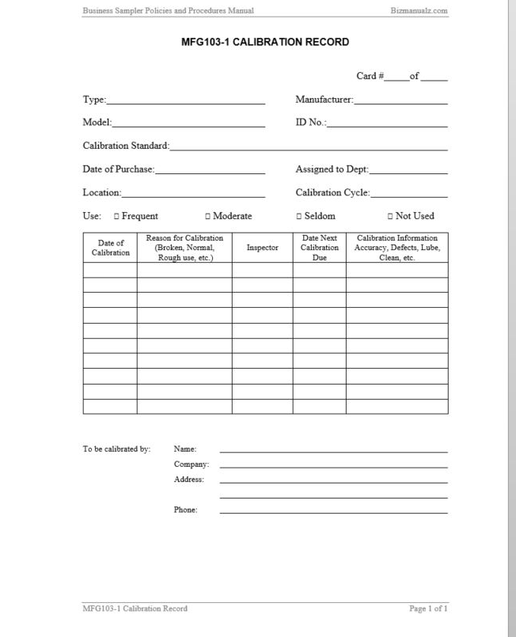
Calibration Record

Slide 21
Significance of Validation in GLP
Validation is the process of establishing documentary evidence demonstrating that a procedure, process, or activity carried out in testing and then production maintains the desired level of compliance at all stages.
In GLP, one of the key aspects that is considered is monitoring the study as we had seen earlier.
Therefore, validation in GLP is of great importance.
Validation in GLP ensures that the activities carried out comply with the requirements/ standards.
Thus, validation also indirectly ensures that the quality is maintained.
Also, since, validation also involves establishing documentary evidence, it is important to GLP in terms of its aspect of documentation/recording.

Slide 22
Transfer of Methods
The transfer of analytical procedures (TAP), also referred to as method transfer, is the documented process that qualifies a laboratory (the receiving unit) to use an analytical test procedure that was first followed in another laboratory (the transferring unit).
The transfer of method ensures that the receiving unit has the knowledge about the procedure and the ability to perform the transferred procedure as intended.
There are various approaches by which a TAP can be carried out.
The most common approach is comparative testing where the analysis of a predetermined number of samples of the same lot by both the sending and the receiving units is carried out.

Slide 23
Another approach which can be used is co-validation where the transferring unit can involve the receiving unit in an inter-laboratory co-validation, including them as a part of the validation team at the transferring unit and thereby obtaining data for the assessment of reproducibility.
This assessment is made using a preapproved transfer or validation protocol that provides the details of the procedure, the samples to be used, and the predetermined acceptance criteria.
Revalidation or partial revalidation is another approach which is acceptable for the transfer of a validated procedure.

Slide 24
Under certain circumstances, the normal TAP may not be done.
In such cases, the receiving unit is qualified to use the analytical test procedures without comparison and creation of inter-laboratory comparative data.
Scenarios that justify a transfer waiver:-
The new product’s composition is comparable to that of an existing product and/or the concentration of active ingredient is like that of an existing product and is analysed by procedures with which the receiving unit already has experience

Slide 25
The analytical procedure transferred is the same as or very similar to a procedure already in use.
The personnel in charge of the development, validation, or routine analysis of the product at the transferring unit is moved to the receiving unit.
If eligible for transfer waiver, the receiving unit should document it with appropriate justifications.

Slide 26
When the TAP is successfully completed, the receiving unit should prepare a transfer report that describes the results obtained in relation to the acceptance criteria, along with conclusions that confirm that the receiving unit is now qualified to run the procedure.
Any deviations should be thoroughly documented and justified.
If the acceptance criteria are met, the TAP is successful, and the receiving unit is qualified to run the procedure.
Otherwise, the procedure cannot be considered transferred until effective remedial steps are adopted to meet the acceptance criteria.

Slide 27
Documentation of Results
The final step to be performed during an analysis/ a study is the documentation of results.
Good record keeping, as we have seen earlier, is essential for complete reconstruction and accurate reporting of a study.
If data are lost or a record is incomplete, the study and its results may be seriously compromised.
Raw data are defined as original results recorded during the study. These data are necessary for the reconstruction of the study (for example, by a senior scientist or an inspector) after the study completion date.

Slide 28
The raw data should include the following:-
A) What was done:- Describing procedures carried out and demonstrating that the instructions in the protocol were carried out and that relevant SOPs were followed and that the results of the observation or measurement were included.
B) How it was done:- Indicating that data were collected and recorded in accordance with the methods set out in the SOPs and protocol. There should be indications of any deviations from the instructions.
C) When the work was performed:-
Demonstrating that the timeline specified in the SOP was followed. This should be done by recording the date, and, if necessary, the time at which procedures were carried out. For certain procedures very exact timing is necessary and the data must demonstrate that the schedule has been followed.

Slide 29
Who performed the work:- The data should clearly identify who was responsible for carrying out the procedure and recording the data. Where more than one person was involved in a procedure this should be recorded in the data and the responsibilities of each described.
At the conclusion of a study, a final study report is prepared.
This study report is the responsibility of a study director.

Slide 30
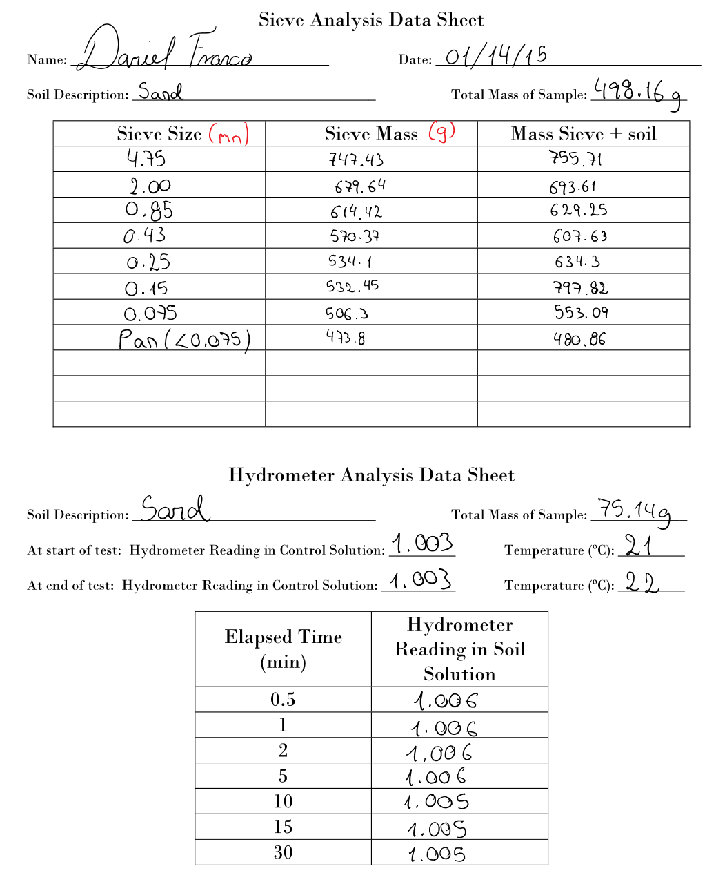
Raw Data example

Slide 31
It must include the following:-
Name and address of test facility
Dates of start and finish of the study
Name of study director
Objectives of the study
Details of test items and vehicles
Description of the test system
Details of dosing, route and duration

Slide 32
Summary of findings
Discussion
Conclusion
References
GLP compliance statement from the study director
QA statement of inspections/audits
Signed/dated reports from contributing scientists.

Slide 33
The study director is responsible for the entire study, including the report.
He/she must make sure that the study report describes the study accurately.
The study director is also responsible for the scientific interpretation of study results.
Finally, the study director must indicate in the study director’s GLP compliance statement as to whether the study was performed in compliance with the GLP principles.
If the study was not fully compliant, those parts that were not compliant must be identified in the report.

Slide 34
“The report should fully and accurately reflect the raw data.”
It means that everything that happened during the study should be reported but does not necessarily mean that every piece of raw data should be included in the report.
The report should allow the reader to follow the course of the experiment and the interpretation without the need to refer to outside material.
The report should not be a selection of “highlights” of the study, leaving out the part that did not work or overlooking restarts that were needed for some reason.

Slide 35
The report should always cover all aspects of the study that deviated from the original intention as laid down in the protocol or the SOPs, whether this is considered to have impacted the study integrity or not.
The report may include input from scientists other than the study director, such as specialists within the test facility or from outside consultants or the sponsor.
These may form parts of the report, signed and dated by the contributing scientist.
Data from outside the test facility should have been derived in compliance with GLP. If this is not the case, the study director should indicate this in his/her GLP compliance statement.

Slide 36
GLP requires the study director to include a statement in the report accepting responsibility for the validity of all data in the report, even that of contributing scientists, and confirming that the study was performed in compliance with GLP.
After the report has been drafted, it will pass through a review stage and a quality assurance audit.
During this period modifications may be made to the report, but it is important that all modifications are approved by the study director.
The process of approval prior to finalization may involve both peer review by other scientists and a review by the sponsor.

Slide 37
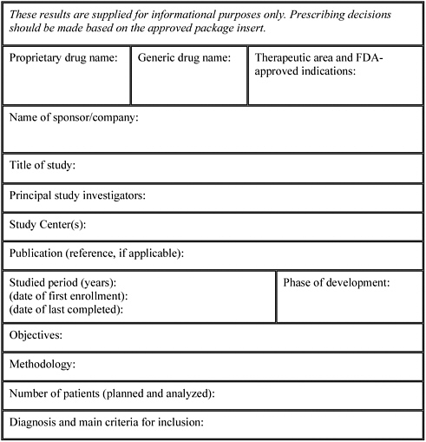
Study Report Format

Slide 38
It is important that all accepted changes be incorporated before finalization of the report as the report cannot be modified once the study director has approved and signed it.
After finalization, modifications can only be made by a formal amendment, which is a separate document attached to the unmodified report.
Such amendments must be signed and approved by the study director who identifies the change and the reason for amending the report.

Slide 39
References
https://bizfluent.com/facts-7639144-importance-glp.html
https://en.wikipedia.org/wiki/Good_laboratory_practice
https://ntp.niehs.nih.gov/iccvam/suppdocs/feddocs/oecd/oecd_glpcm.pdf
https://en.wikipedia.org/wiki/Good_documentation_practice
http://www.biopharminternational.com/glps-and-importance-standard-operating-procedures
http://www.biopharminternational.com/glps-and-importance-standard-operating-procedures?id=&sk=&date=&pageID=2

Slide 40
https://calibrationawareness.com/elements-in-implementing-internal-calibration-laboratory
https://en.wikipedia.org/wiki/Validation_(drug_manufacture)
https://hmc.usp.org/sites/default/files/documents/HMC/GCs-Pdfs/c1224.pdf
https://proto.ufsc.br/files/2012/03/glp_trainee_green.pdf

Slide 41


